Slide 1
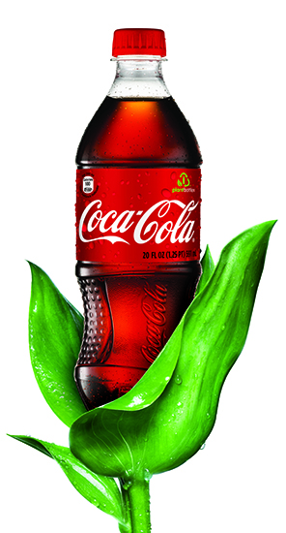
Making Big Ideas Happen

Slide 2
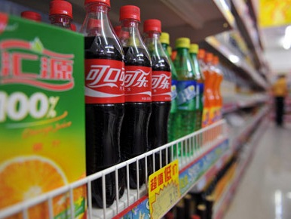
15
207
3,500
700,000
20,000,000
1,800,000,000
Notes:
TCCC BY NUMBERS
15 billion dollar brands
206 countries (we’re a giant network of local companies in 206 countries—more than the UN)
3500 products
700,000 employees
20 million customers
1.8 billion servings a day
REFLECT ON TWO NUMBERS:
3,500 product offerings. Highlights local nature of our business made up of over 300 independent bottlers. We make locally relevant products to meet specific needs and desires. Our business depends on long-term sustainability of local resources (we aren’t shipping products all over the world)
1.8Billion servings w/ 2020 vision to grow our business further. Well grounded in reality of evolving macro trends – resource scarcity, eco impacts, rising customer and consumer expectations. To deliver sustainable growth we not only are becoming more efficient (less bad) but also advancing new breakthrough technologies that enable us to refresh consumers while doing more good
Quickly reference water/ag and climate work
Transition focus to packaging and how we deliver refreshment to consumers

Slide 3
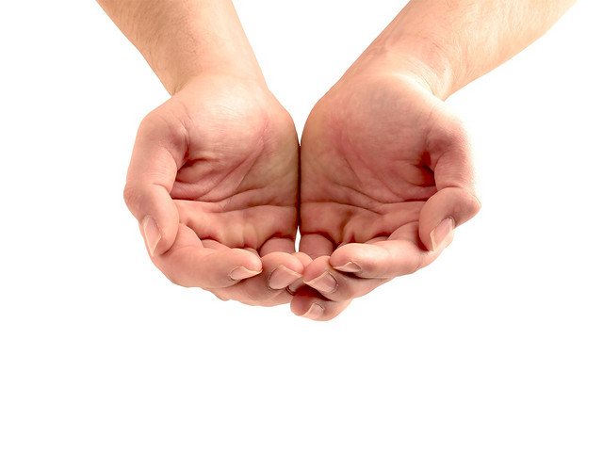
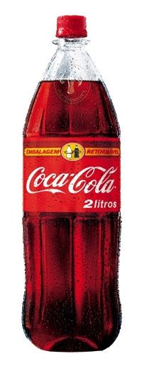
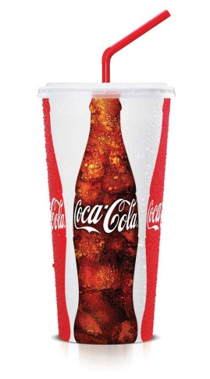
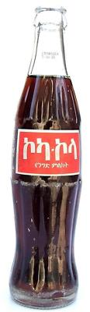
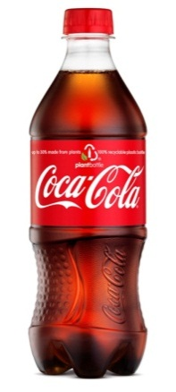
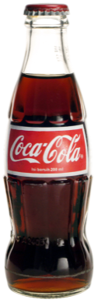
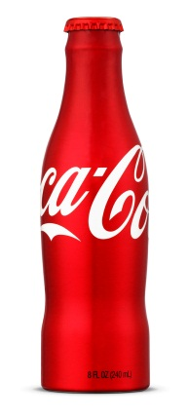
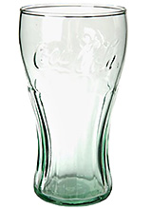
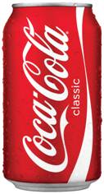
Fountain 10%
Refillable Glass 12%
Metal 14%
PET Plastic 51%
Non-Refillable Glass 1%
Refillable PET Plastic 7%

Slide 4
“The best way to predict the future is to design it”
- Buckminster Fuller
Notes:
Assumes we focus on continuous improvement. For PET…advance lower carbon solutions, manage cost and continue to meet consumer need

Slide 5
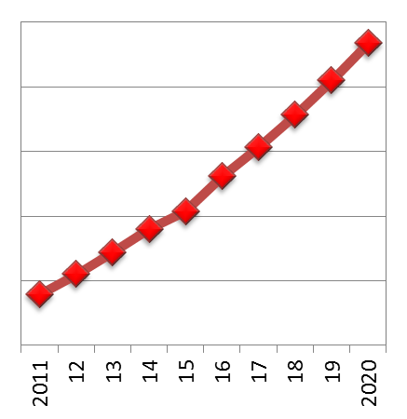
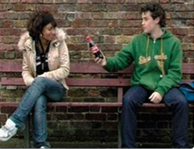
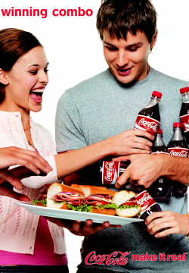
CONSUMER VALUE PET bottle tops for delivering refreshment today…and tomorrow
Nearly 60% of KO Volume Delivered in PET
PET Demand to DOUBLE by 2020
5

Slide 6




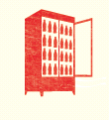
ECOSYSTEM VALUE Packaging is our largest CO₂ source
INGREDIENTS
PACKAGING
MANUFACTURING
DISTRIBUTION
REFRIGERATION
Sweeteners
Ingredient CO₂
Juice, Coffee, Tea
Primary
Secondary
Fuel
Electricity
Trucking Fleet
Refrigerants
Electricity
CO₂e
13%
38%
9%
8%
32%
H₂O
79%
20%
1%
--%
--%
6

Slide 7
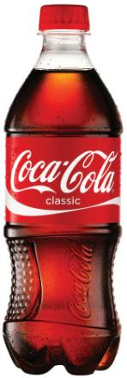
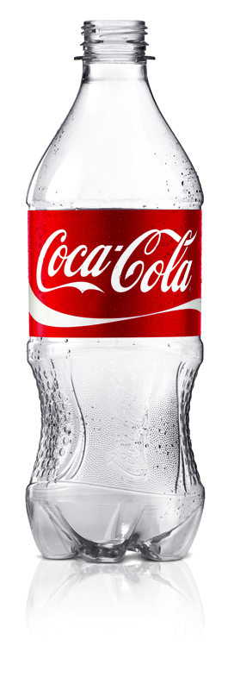
BOTTOM LINE VALUE PACKAGING: KEY COST COMPONENT
BOTTLE COST
~30%
7

Slide 8
BOTTOM LINE VALUE Packaging is a key cost component of our products (sample cost of 20oz Coca-Cola Classic)
BOTTLE COST
~30%
8

Slide 9
lean
green
& loved

Slide 10
PlantBottle™ Technology Pathway
[PlantBottle PET 2.0]
Bio-PTA (70%)
Recycled/Reused PET
Ingredient 1
[PTA]
70% by Weight
Plant-Material
(sugars)
Petro-Material
(oil, natural gas)
Polyester Plastic
Bottle
Consumer
Ingredient 2
[MEG]
30% by Weight
Bio-MEG (30%)
[PlantBottle PET 1.0]

Slide 11

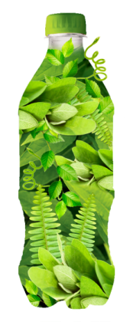
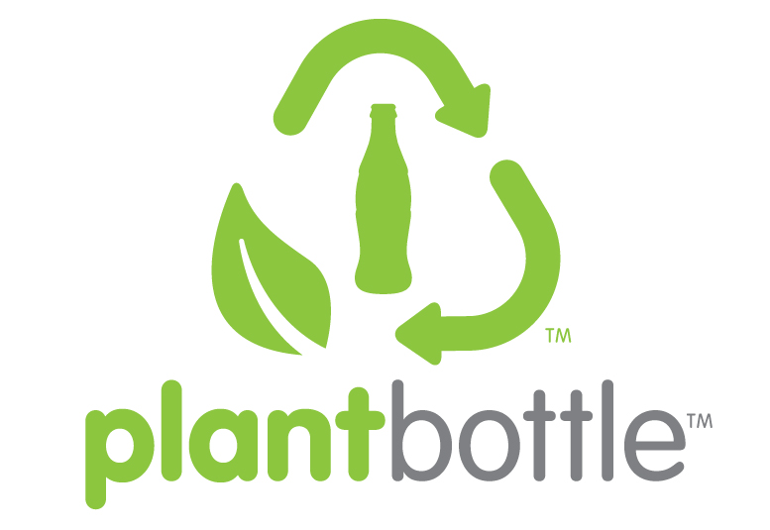
PlantBottle™ Packaging
+
+
=
Functional
Recyclable
Renewable

Slide 12
PlantBottle™ Commercial Strategy
PlantBottle PET 1.0
PlantBottle PET 2.0
Logistics Optimization
Bottom Line Value
(lean)
COST
(GLOBAL)
Top Line Value
(loved)
Production Expansion
Traditional PET
Commoditization
EcoSystem Value (green)
2010
2015
2020

Slide 13

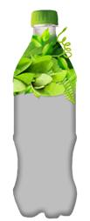
Back Integration Into PET Supply Chain
Gasoline
Px
PTA
Crude Oil
& Nat. Gas
Naphtha
&
Ethane
Ethylene
MEG
PET RESIN
PET
Bottle
Sugar Cane
Ethanol
bEthylene
bMEG
2nd Gen Feedstock
Sugar
Active Purchases
Hedge / Monitor / Influence
Monitor / no Influence
More tools to hedge sugar cane/ethanol and offer greater price certainty
TCCC is already the largest sugar buyer in the world
2nd Gen feedstocks will further enhance portfolio options

Slide 14







Building A Leaner Local Supply Strategy
PHASE 1: 2010
Sole feedstock, bMEG & bPET sources.
PHASE 2: 2011-2013:
Regional bPET suppliers and start of bMEG expansion.
1
PLANT
1
PLANT
4
PLANTS
1
PLANT
1
PLANT
1
PLANT
3
PLANTS
1
PLANT
1
PLANT
Feedstock
Source
bMEG
Plant
bPET
Plant
Feedstock
Source
bMEG
Plant
bPET
Plant
PHASE 3 : 2014-16
Expanded bMEG capacity in the Americas & Asia. Emergence of plant waste feedstocks.
Phase 4: 2017-2020
Local bMEG & bPET capacity in strategic markets. Diverse local feedstocks sourced responsibly.
2
2
PLANTS
PLANTS
1
PLANT
4
PLANTS
1
PLANT
3
PLANTS
1
PLANT
1
PLANT
1
PLANT
Feedstock
Source
bMEG
Plant
bPET
Plant
Feedstock
Source
bMEG
Plant
bPET
Plant
*Does not account for likely supply growth beyond CC
14

Slide 15
LET US KNOW IF YOU WANT/NEED MORE SHOWING COST MODEL WE HAVE A LOT MORE IF HELPFUL

Slide 16
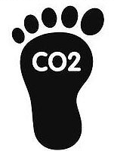



More than 140,000 MTs of CO2 emissions removed since launch - equivalent to over 300,000 barrels of oil
Reducing dependency on fossil-based materials and enhancing local energy security
green
Only plastic made from plants that is fully recyclable and can meet the quality requirements of our core products
Potential to increase local farmer value and yield

Slide 17





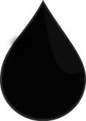

Leveraging the Carbon Cycle in Circular Design
CO²
emissions
removal
recycle
conversion
Plant Source
PlantBottle Value:
Less Dependent on Fossil Materials
Lower Material Carbon Footprint
Closed Loop Recycling Chain
Meets Consumer Beverage Needs
Nonrenewable Carbon Sources
(Oil & Natural Gas)

Slide 18







Feedstock Sustainability
Demonstrated improvement in environmental & social performance
No detrimental impact on local food security
Life Cycle Performance
Responsible Sourcing

Slide 19

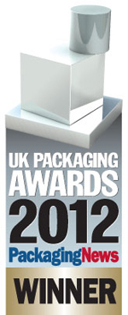
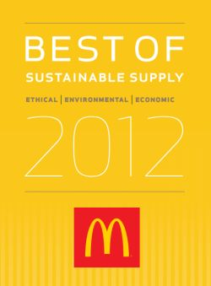

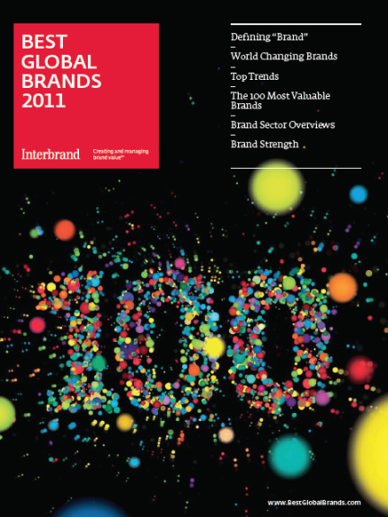











Awards & Recognition

Slide 20

LOVE.

Slide 21
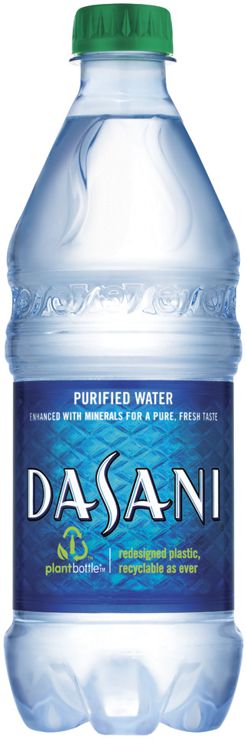
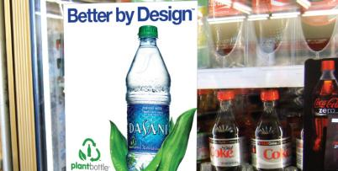
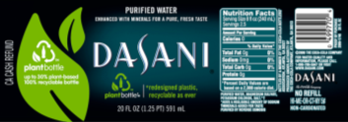
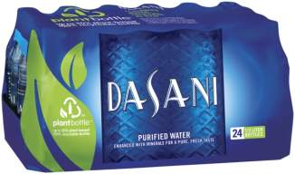
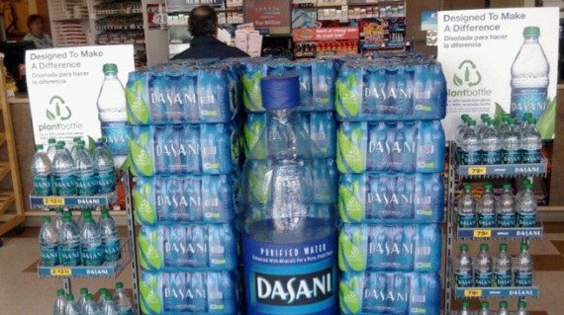
NATURE
love

Slide 22

Notes:
Local source language question

Slide 23



DASANI: Outstanding Business Results Over the Past Two Years
Favorite Brand
Leadership
vs. Key Competitor
Value Share
Swing
vs. Key Competitor
2x Category
Growth
2.0x
from
1.4x
+2.1 pts
Consumer Perception
BRAND IS A LEADER IN
ECO-FRIENDLY PACKAGE
+50 Million
Incremental Unit Cases
+ 14 pts
Authorizations:
+25,000 outlets
Notes:
V/O: Dasani has had a fantastic year in 2011…volume growth up more than 27 million cases and outpacing the category growth by more than 2 and a half times.
DASANI also led the category in share gains, and expanded its leadership on Favorite Brand over our closest competitor.
In addition, DASANI was relisted in over 25,000 retail outlets
And here’s how we did it….
Visuals:
Build slide as V/O hits upon each message

Slide 24
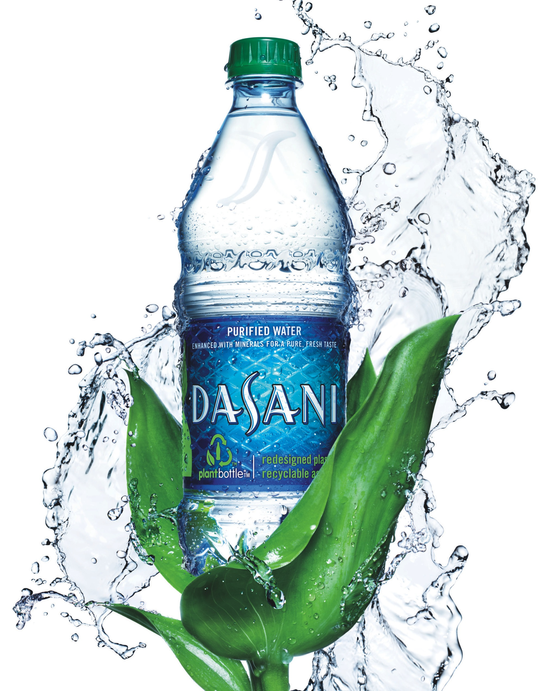
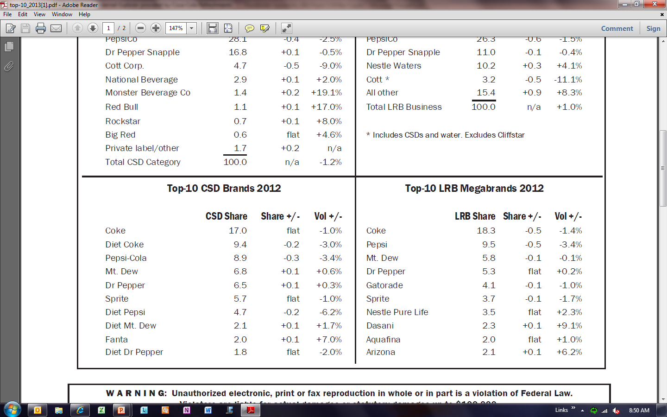
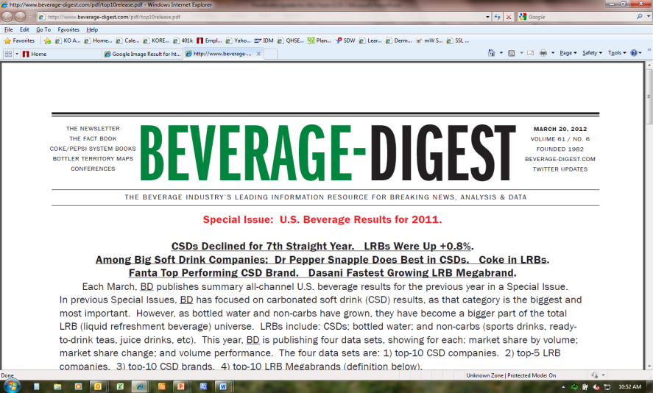

Slide 25
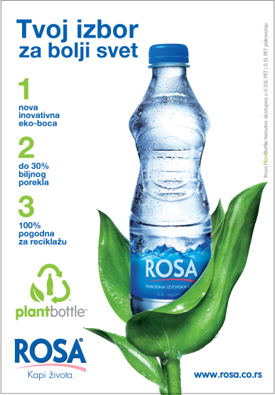

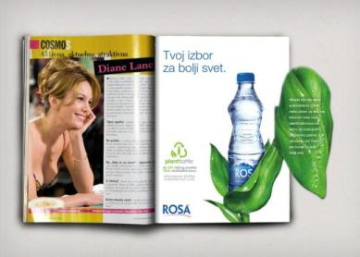
Clear and Effective Print
It is all about simple choices 1, 2, 3…
Innovative Print
Capture and enthuse the consumer
Your Choice for better world
1 2 3
new innovative up to 30% 100%
eco-bottle plant based recyclable

Slide 27
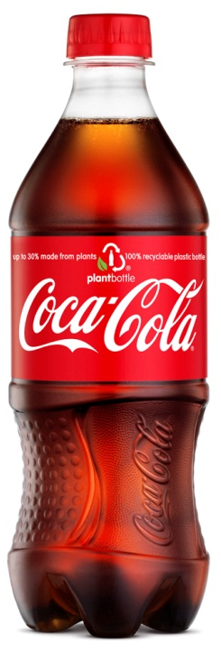

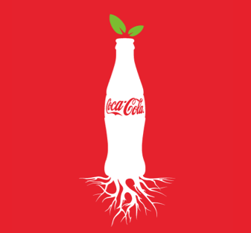
love
PLANTS MAKE US HAPPY

Slide 28
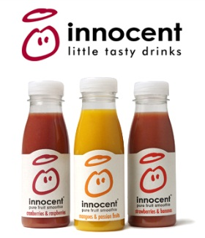
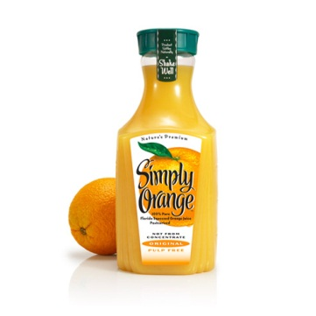
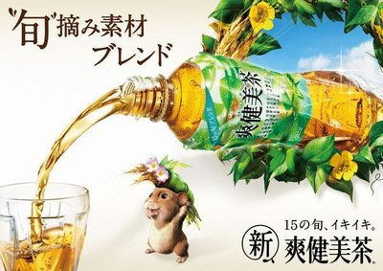
Natural Inside….
love
…Natural Outside

Slide 29


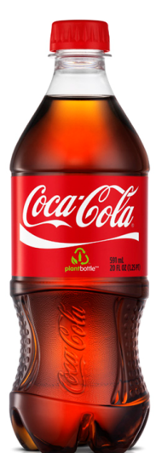
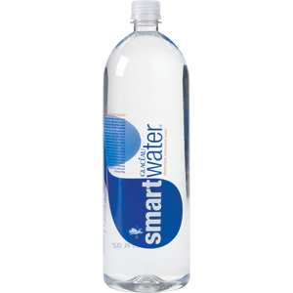
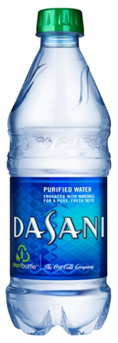

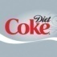


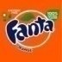
4
3
PLAN FOR THE FUTURE
DELIVER SPARKLING LEARNINGS
2
EXPAND WATER CATEGORY
1
REINVENT
WITH TWIST

Slide 30
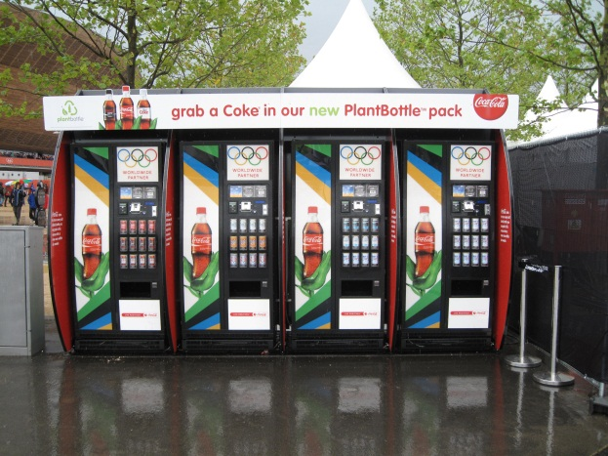
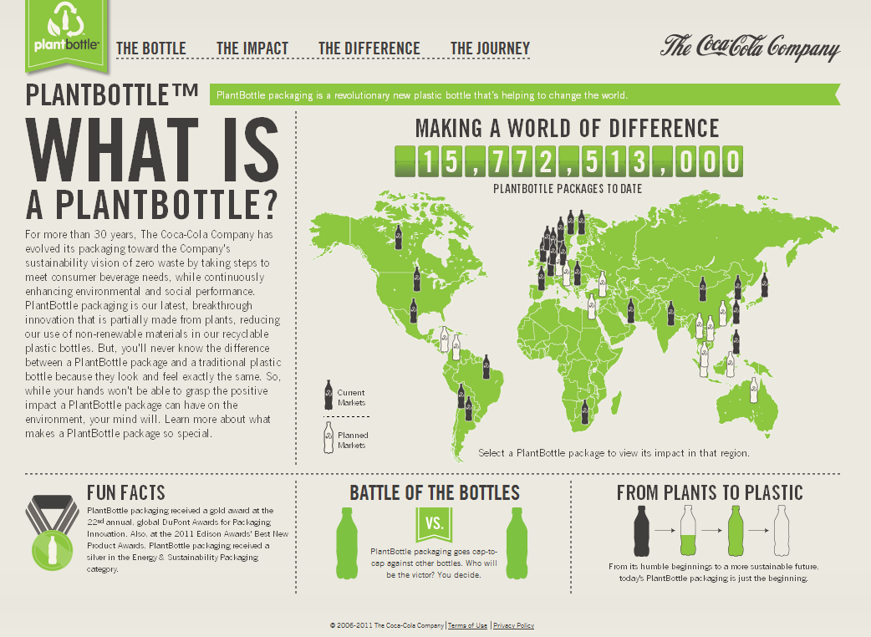
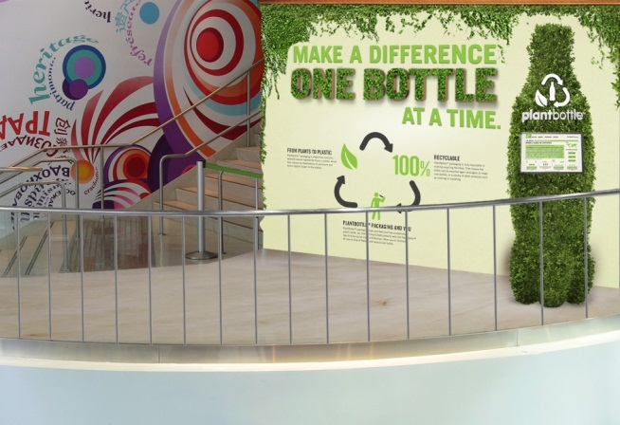
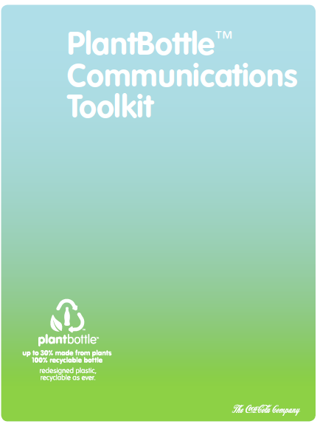
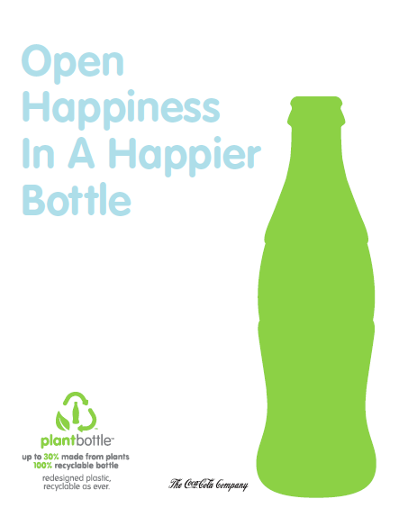

Strategic Communications
PlantBottle MicroSite
Olympics
WOCC
Associate Tools
World Expo
30

Slide 31


Strategic Communications
Coca-Cola Journey
(1.2MM visitors/month)
World of Coca-Cola

Slide 32


Slide 33











Robust R&D pipeline
PlantBottle 1.0
Biomass
PlantBottle 2.0

Slide 34









Opportunity Collaboration
technology collaborative
34

Slide 35
Cross-Functional Collaboration
SPONSOR: Ron Lewis, CPO
PROGRAM OPS
Lisa Mason-Sanders
GENERAL MANAGER
Scott Vitters
MARKETING OPS
Andrew Rodbell
GROUP LEADS
EUROPE
Klaus Stadler
RESEARCH
Yu Shi
BRAND MKTG (Coke)
G. Duncan
LATIN AMERICA
Marcelino Martinez
DEVELOPMENT
Mike Schultheis
BRAND MKTG (H20)
S. Castell
NORTH AMERICA
Chris Gaffney
PROCUREMENT
Miki Knutzen
LIVE + MKTG
Javier Rodriguez Marino
EURASIA & AFRICA
Cumhur Karci
EOSH
Himanshu Jani
CUSTOMER MKTG
Jeff Foote
PACIFIC
Marina Palma
SUSTAINABILITY
Anna Shealy
COMMUNICATION
Katherine Schermerhorn
SUSTAINABILE AG
Ben Jordan
LEGAL
Vail Thorne
FUNCTIONAL SUPPORT
LEGAL
Nicole Morris (IP)
Keely Herrick (TM)
Bill Lee (R&D)
Lawton Hawkins (GSP)
Anthony Cabrera
M&A
Shellie Davis
SUSTAINABLE AG
Denise Knight
Ernesto Brovelli
SWEETNER
Ankush Singal (India)
Orlando de Albuquerque (Brazil)
FINANCE
Karen Davis
PAC
Kate Irvin
K. Black
Jen Ragland
R&D
Shell Huang
Sheng Sheng Yang
Linda Liu
Chris Mubarak
Rob Kriegel
K&I
Anne McAllester
SRA
Forrest Bayer

Slide 36



